Slide 1
Deep Learning on Graphs with Graph Convolutional Network
Csc215 – Final Project
By – Himanshu Chauhan

Slide 2
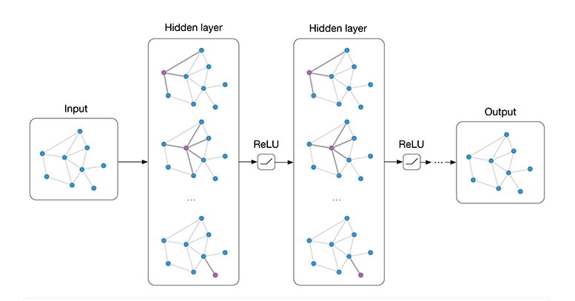
Why GCN ?
If we have a lot of data in a form of graph, how will we get this kind of graph structure into some kind of deep learning architecture
Today, lots of learning tasks require dealing with graph data which contains rich relation information among elements.
Many system requires that a model learns from graph inputs.

Slide 3
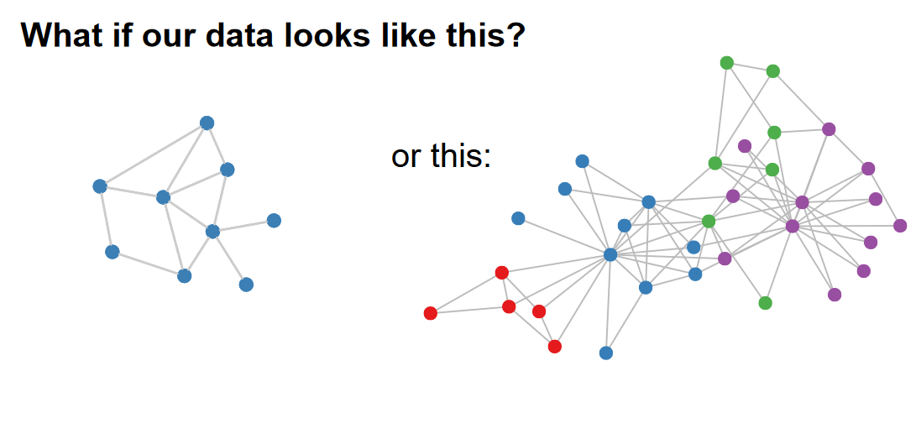
Graph Structured Data

Slide 4
Applications
Some application areas for GCN could be :
Node classification or link prediction.
Examples:
Facebook ego network
Fraud detection
Social networks
World -wide-web
knowledge graphs
GCN are not just to classify or make predictions but can also be used to produce graphs.

Slide 5
Why Not CNN ?
The motivation for graph neural network goes back to convolutional neural network.
CNN’s can only operate on regular Euclidean data like images and text while these data structures can be regarded as instances of graphs.
Unlike standard neural networks, graph neural networks retain a state that can represent information from its neighborhood with arbitrary depth.

Slide 6
Graph Convolution Network - GCN
GCNs are a very powerful neural network architecture for machine learning on graphs.
In fact, they are so powerful that even a randomly initiated 2-layer GCN can produce useful feature representations of nodes in networks. A graph convolutional network (GCN) is a neural network that operates on graphs.
Given a graph G = (V, E), a GCN takes as input:
an input feature matrix N × F⁰ feature matrix, X, where N is the number of nodes and F⁰ is the number of input features for each node, and
an N × N matrix representation of the graph structure such as the adjacency matrix A of G. [1]

Slide 7
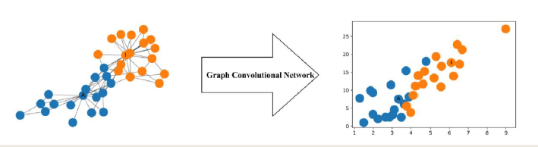
For example, the figure below illustrates a 2-dimensional representation of each node in a network produced by such a GCN.

Slide 8
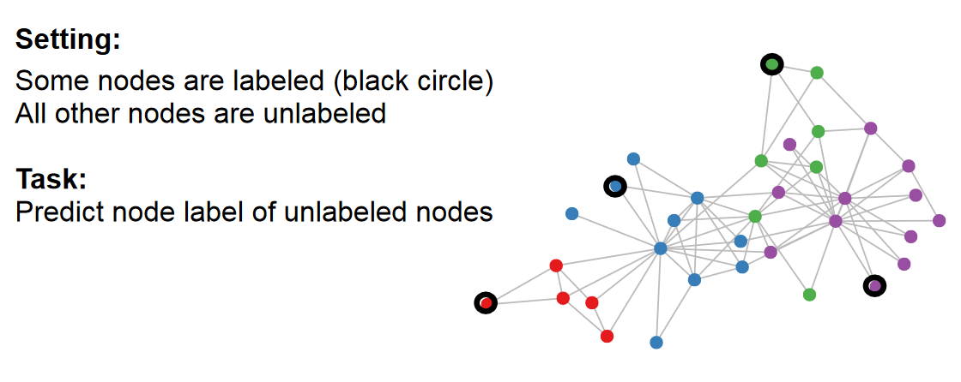
Semi-supervised classification with graph convolutional network

Slide 9
Implementation of GCN
Implemented using PyTorch Library - Facebook
Deep Graph Library (DGL)
DGL is a Python package dedicated to deep learning on graphs, built atop existing tensor DL frameworks (e.g. Pytorch, MXNet) and simplifying the implementation of graph-based neural networks.
Networkx
DGLGraph

Slide 10
Step Followed to implement GCN
Pytorch and tensors
Model implementation using pytorch
Graphs using DGL
Understand how DGL enables computation on graph from a high level.
Train a simple graph neural network in DGL to classify nodes in a graph.
GCN Implementation using pytorch and DGL

Slide 11
Graph neural network in DGL to classify nodes in a graph Creating and Implementing Graph from Scratch
Step 1
Adding Nodes
Step 2
Step 3
Message Passing
Step 4
Defining GCN model
Train
Test
Visualize
Send Message
Receive Message
Edges Features
Assigning Features
Nodes Features
Adding Edges
Creating a graph in DGL

Slide 12
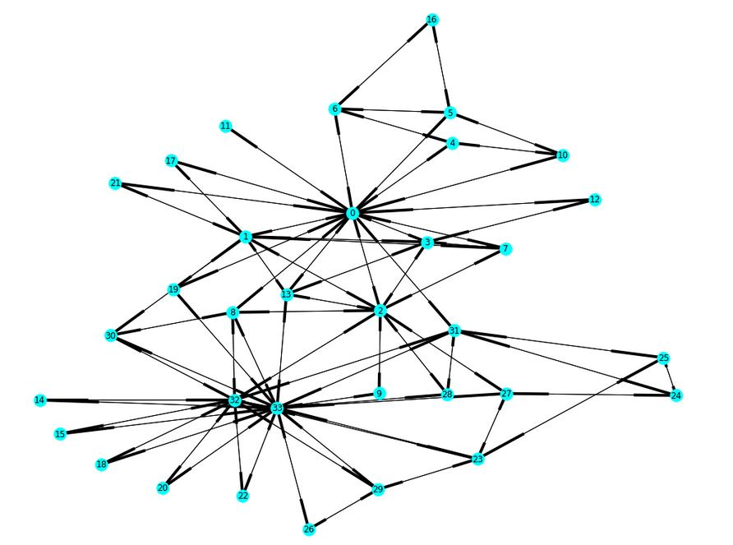
“Zachary’s karate club” problem
The club later divides into two communities led by the instructor (node 0) and the club president (node 33)
Zachary’s Karate Club Dataset
Total nodes: 34
Labelled nodes: 2 (node 0 and node 33)
Input given: graph and features (one-hot encoded)
Calculated loss on labelled nodes to train model
Output: Predicted label for unlabelled nodes

Slide 13
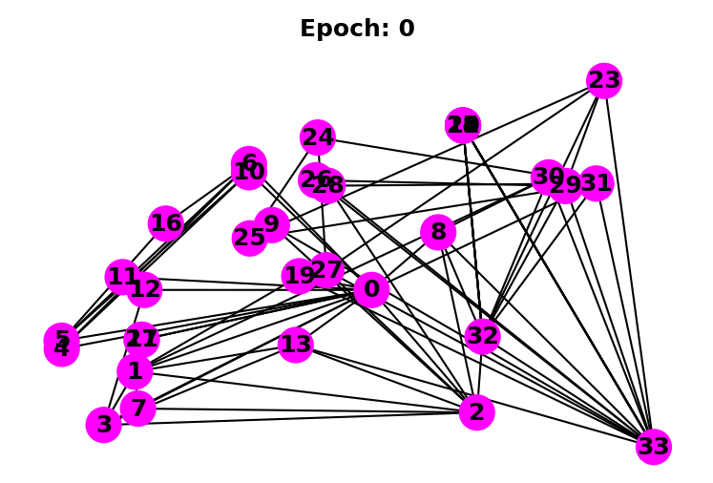
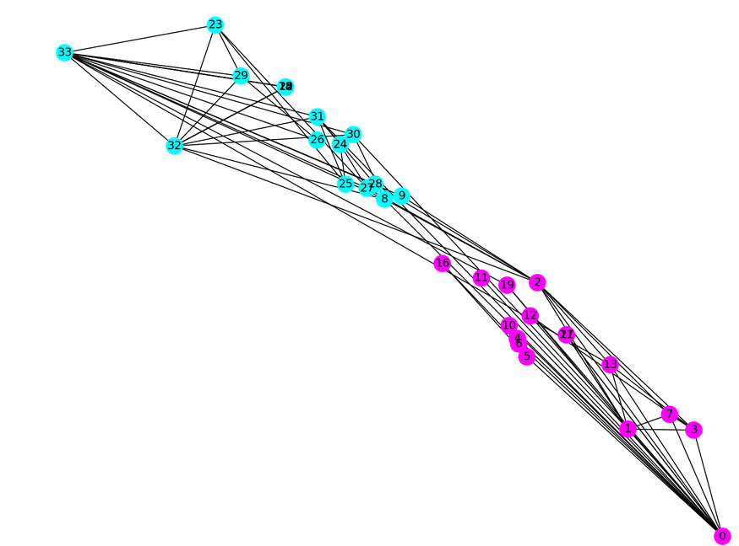
Results

Slide 14
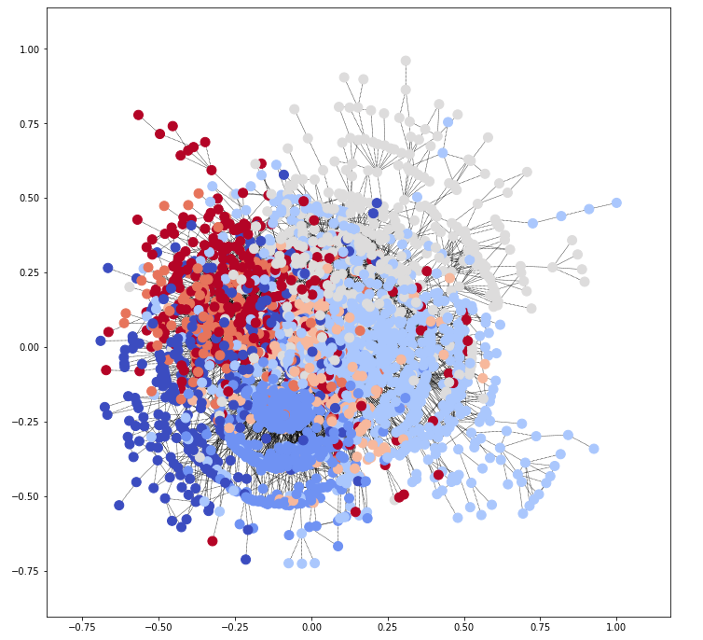
GCN Implementation – Cora dataset
Cora Graph Dataset
Total nodes: 2708
Labelled nodes: 140 (5% of total nodes)
Total edges: 10556
Total Features: 1433 features for each node
Input given: graph and features
Calculated loss on labelled nodes to train model
Output: Predicted label for unlabelled nodes

Slide 15
4.2.1 Experimental Settings
Three GCN layers
Input Size: 1433; Hidden size: 32 and 16
Output size: 7
Optimizer: Adam
Learning Rate: le-3
Activation function: relu
Output Layer Activation function: SoftMax
Loss Function: nll_loss
Used NetworkX python package for studying and analysing the graph structure
Number of Epochs: 300
Metrics Used for model evaluation: Accuracy Score, F1 Score, Recall Score, Precision Score

Slide 16
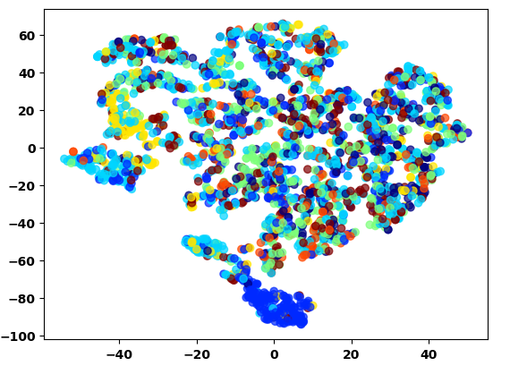
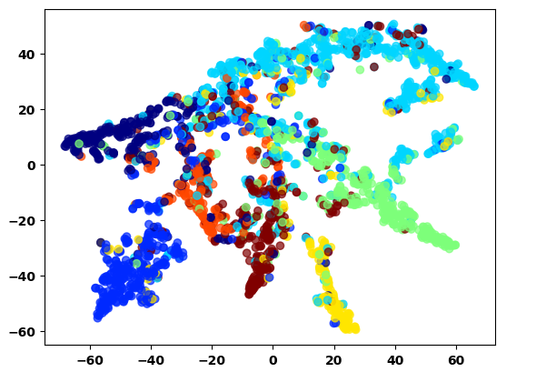
Used TNSE Dimensional reduction – For Visualization Epoch -0 v/s Epoch-1000

Slide 17
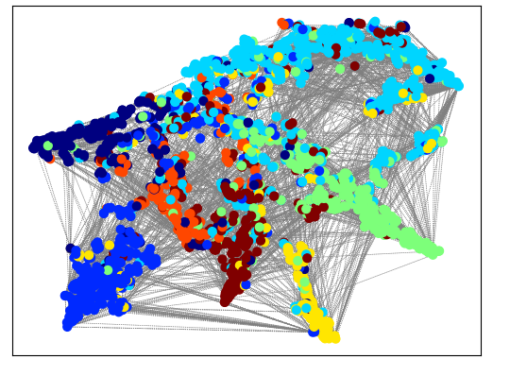
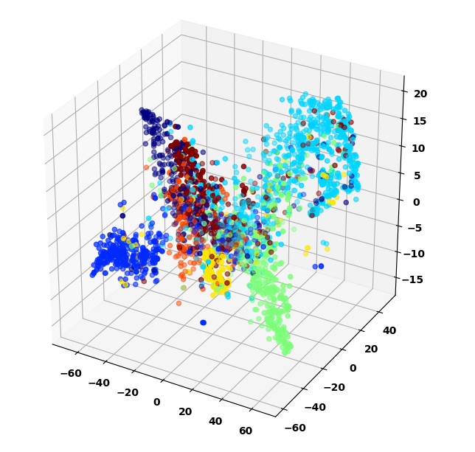
3D Visualization

Slide 18
Results
Model | Accuracy | F1 Score | Recall | Precision
2 GCN (500 epochs) 140 nodes | 0.97 | 0.9722 | 0.977 | 0.977
2 GCN (500 epochs) Test data | 0.661 | 0.6488 | 0.6388 | 0.6278
3GCN-layers (1500 epochs) + 2 Dropout Layers Train data 140 nodes | 0.89 | 0.88 | 0.89 | 0.87
3GCN-layers (1500 epochs) + 2 Dropout Layers Test data 1000 nodes | 0.65 | 0.64 | 0.65 | 0.64
3GCN-layers (1500 epochs) + 2 Dropout Layers Test data 300 nodes | 0.73 | 0.73 | 0.723 | 0.73
3GCN-layers (1000 epochs) + Dropout Layer Train data 140 nodes | 0.98 | 0.98 | 0.98 | 0.98
3GCN-layers (1000 epochs) + Dropout Layer Test data 1000 nodes | 0.76 | 0.76 | 0.74 | 0.74
3GCN-layers (1000 epochs) + Dropout Layer Test data 300 nodes | 0.7833 | 0.76 | 0.76 | 0.78

Slide 19
Conclusion
Machine learning on graphs is a difficult task due to the highly complex, but also informative graph structure.
GCNs are a very powerful neural network architecture for machine learning on graphs.
In fact, they are so powerful that even a randomly initiated 2-layer GCN can produce useful feature representations of nodes in networks.
Not just limited to node classification but has many other real world applications.

